Slide 1
CREDIT COIN: A PRIVACY PRESERVING BLOCKCHAIN BASED INCENTIVE ANNOUNCEMENT NETWORK FOR SMART VEHICLE COMMMUNICATION
TEAM DETAILS:
P.JAYANTH GANESH (21EG505808)
D.DEEPAK NAYAK (21EG505813)
L.PRANEETH KUMAR (21EG505844)
PROJECT SUPERVISOR :
MRS. AMITHA MISHRA
ASSISTANT PROFESSOR

Slide 2
INTRODUCTION
Credit Coin is a new blockchain project that combines privacy technology with smart vehicle communication. It focuses on keeping user data private while encouraging active user involvement through a blockchain-based reward system. The project aims to create a simple and effective announcement network for smart vehicles. It includes essential elements like a specialized blockchain, advanced privacy tools, and a straightforward token system. Credit Coin is set to transform secure and rewarding interactions among smart vehicles

Slide 3
PROBLEM STATEMENT
The current landscape of smart vehicle communication, existing methods lack sufficient privacy measures and fail to provide adequate incentives for user participation. Traditional announcement networks face vulnerabilities, leading to security concerns and inefficiencies. The Credit Coin project addresses these challenges by introducing a privacy-preserving blockchain, an incentive mechanism, and an efficient announcement network.
EXISTING METHODS AND DISADVANTAGES:
1.Centralized Communication Networks:
2. Incentive-Less Participation:
3.Unsecured Announcement Networks:

Slide 4
PROPOSED METHOD
We propose an effective announcement network called CreditCoin, a privacy-preserving incentive announcement network based on Blockchain via an efficient anonymous vehicular announcement aggregation protocol. On the one hand, CreditCoin allows users to send announcements anonymously in the fully trusted environment. On the other hand, with Blockchain, CreditCoin motivates users with incentives to share traffic information.
We design an incentive mechanism based on Blockchain in CreditCoin. Users manage reputation points while they earn or spend coins as incentives. Meanwhile, CreditCoin still preserves privacy and achieves anonymity. Moreover, based on Blockchain, CreditCoin prevents many security attacks and achieves conditional privacy because Trace manager will trace malicious nodes when an unexpected event occurs. In addition, transactions and account information in CreditCoin are tamper-resistant.

Slide 5
PROPOSED METHOD
Initiator vehicle
Message to send
User
Create vehicle network
Trusted authority key generation
Run credit coin stimulation
Trace manager verification
Computation time graph

Slide 6
EXPERIMENT ENVIRONMENT
TOOLS:
TRUFFLE IDE
VS CODE
ETHEREUM
LANGUAGES:
PYTHON
SOLIDITY

Slide 7


Experiment Screen shorts

Slide 8

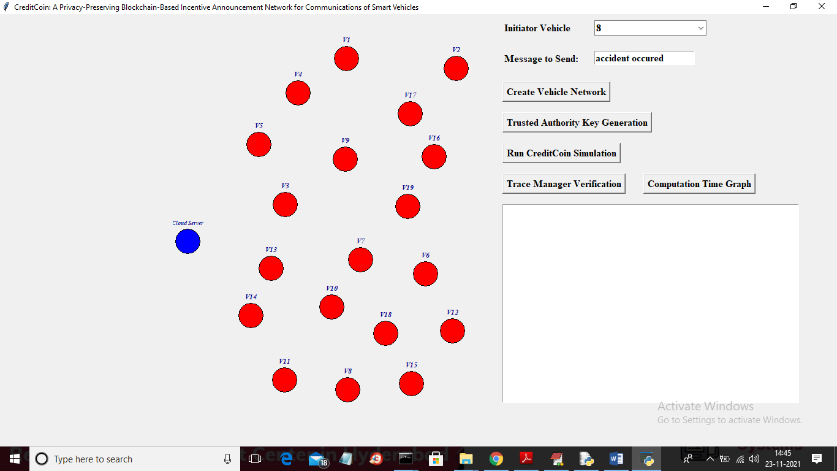
Experiment Screen shorts

Slide 9
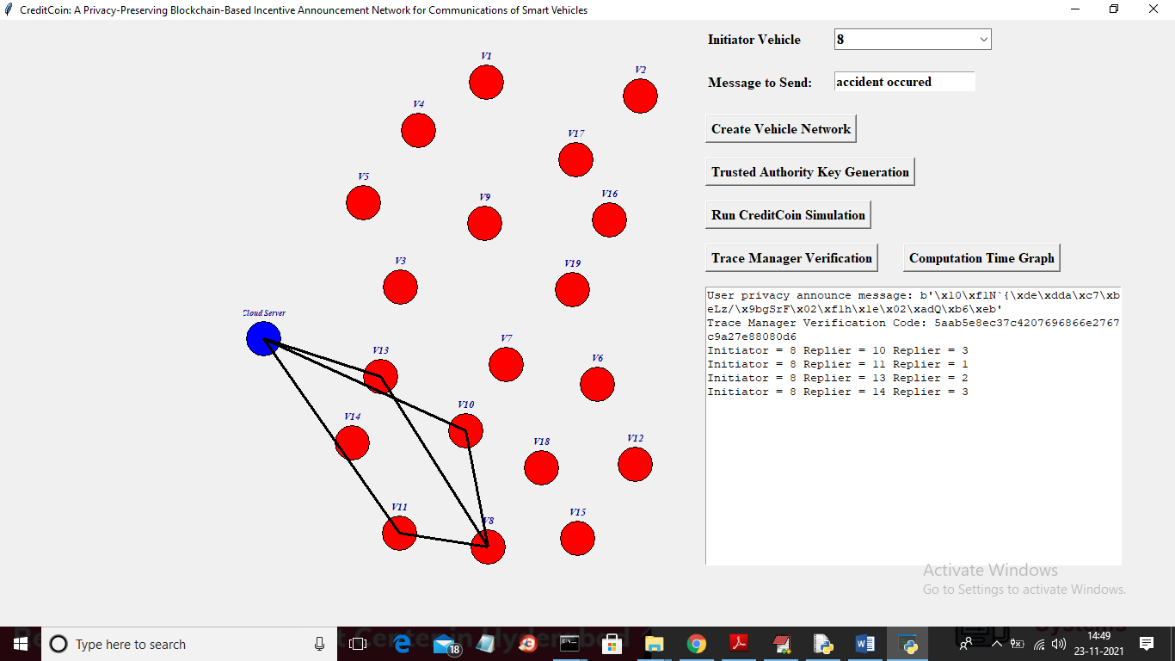
Experiment Results

Slide 10
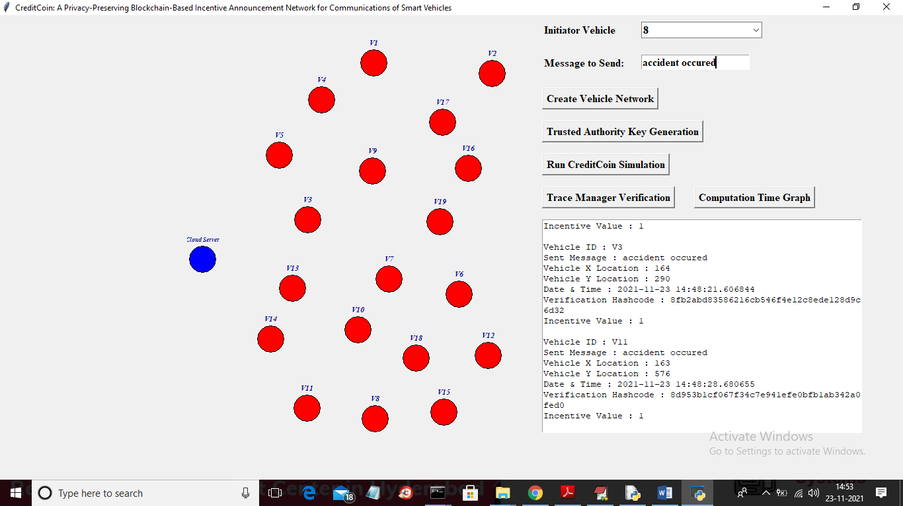
Experiment Results

Slide 11
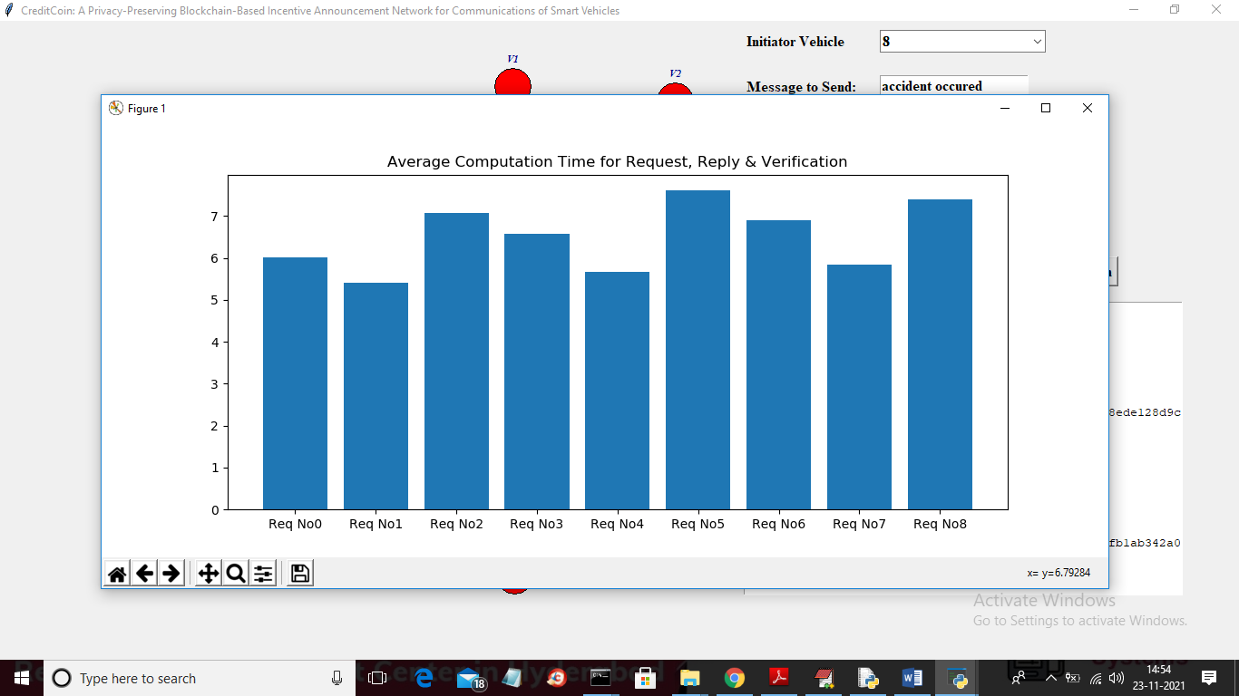
Experiment Results

Slide 12
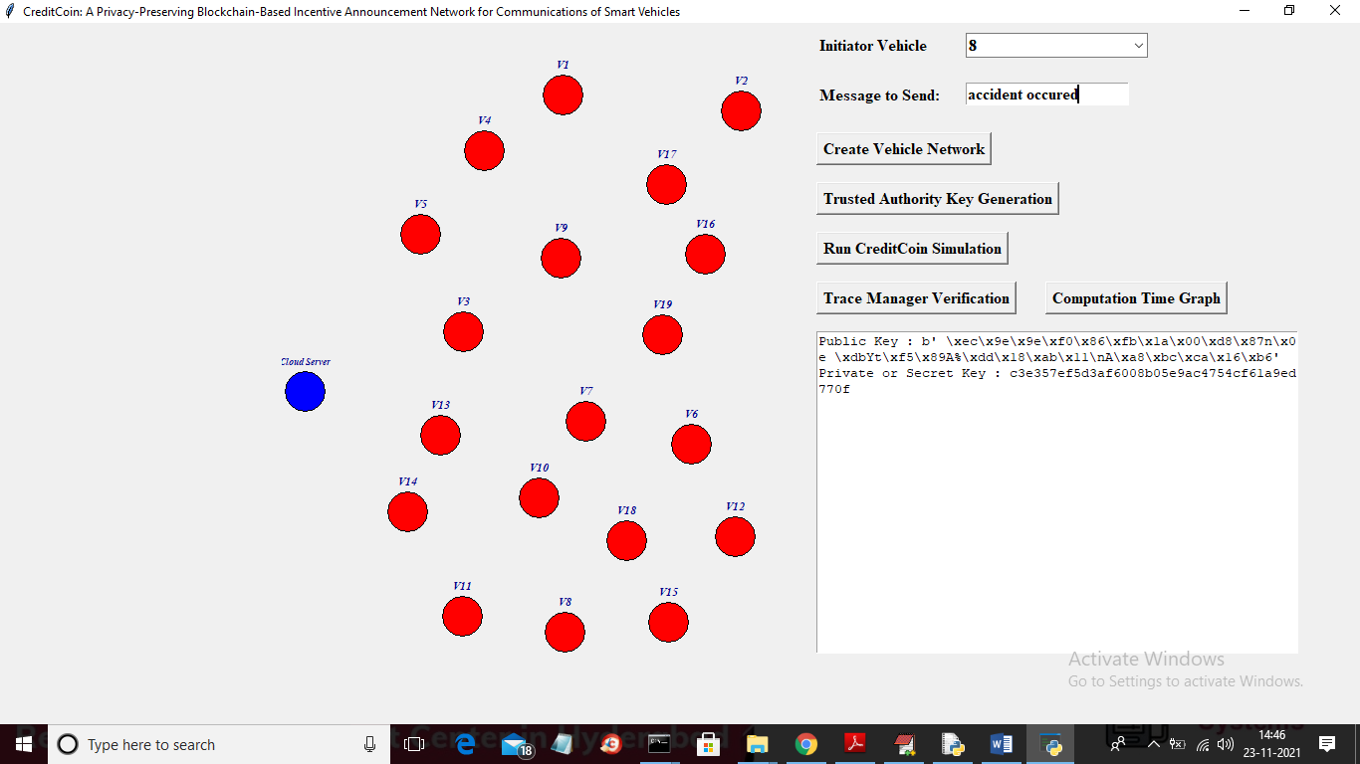
FINDING
While sending the traffic or other information via credit coin using blockchain technology we generated a privacy key which secure the user information and trace the announcement.

Slide 13
JUSTIFICATION
Parameters Improved:
USER ENGAGEMENT(UE) = Number of Active Users / Total User Base * 100
Privacy Score (PS) = Number of Secure Transactions / Total Transactions * 100
Incentive Efficiency (IE) =Total Tokens Distributed / Total User Contributions

Slide 14
THANK YOU

